Slide 1
FOOD RESTURANT WEBSITE
Name: N. Srinu Babu
Reg No: 12217942
Branch: B. Tech (CSE)
Course: Advance Web Development
Course Id: INT222
Faculty: Mamta Sharma
Submission Date: 19-April-2024

Slide 2
INTRODUCTION
Welcome to Yummy, where passion meets innovation to create unforgettable dining experiences we've been dedicated to redefining the culinary landscape with our commitment to quality ingredients and creative flair. From classic comfort dishes to adventurous flavors, our diverse menu caters to every palate. Step into our inviting ambiance and let the warm glow of hospitality envelop you as you embark on a culinary journey like no other. Whether you're sharing a meal with loved ones or savoring a quiet dinner for one, every moment at Yummy is crafted to leave you with cherished memories. Experience culinary excellence with us today.

Slide 3
PROJECT OVERVIEW
1 Home Page:
Use HTML, CSS, and possibly JavaScript to create an attractive layout showcasing the restaurant's ambiance and featured dishes.
Implement a navigation bar using HTML and CSS for easy access to different sections of the website.
Utilize Bootstrap for responsive design, ensuring the layout looks good on various devices.
Include quick links to the menu, chef profiles, table booking, and contact information using HTML anchor tags.
2 Menu Section:
Create a page for the menu using HTML and CSS.
Organize menu items into categories (e.g., appetizers, main courses, desserts) using HTML lists and possibly CSS for styling.
Display each menu item with its description, price, and an option to add to cart.
You can implement the add to cart functionality using JavaScript, possibly with the help of jQuery for DOM manipulation.
3 Chef Profiles:
Create a separate page for chef profiles using HTML and CSS.
Include photos and brief biographies of each chef.
Highlight their specialties and contributions using HTML headings and paragraphs.
You can use Bootstrap for styling the layout and making it responsive.1

Slide 4
4 Table Booking:
Create a dedicated page for table booking using HTML and CSS.
Use Bootstrap to design the booking form, ensuring it's responsive.
Implement JavaScript for form validation to ensure that required fields are filled and that the date and time selected are valid.
Utilize Node.js and Express.js on the backend to handle form submission, validate the input, and store booking details in MongoDB.
Provide a confirmation message upon successful booking, which can be displayed using JavaScript or server-side rendering.
5 Contact Us:
Design a contact us page using HTML, CSS, and Bootstrap.
Include contact information such as address, phone number, and email using HTML elements.
Create a contact form with fields for inquiries, feedback, or special requests using HTML and Bootstrap.
Integrate Google Maps using the Google Maps API to display the restaurant's location and enable easy navigation.
Use JavaScript for form validation and possibly for submitting the form asynchronously to the server.
On the backend, use Node.js and Express.js to handle form submission, send emails for inquiries or feedback, and store contact form submissions in the database if necessary.

Slide 5
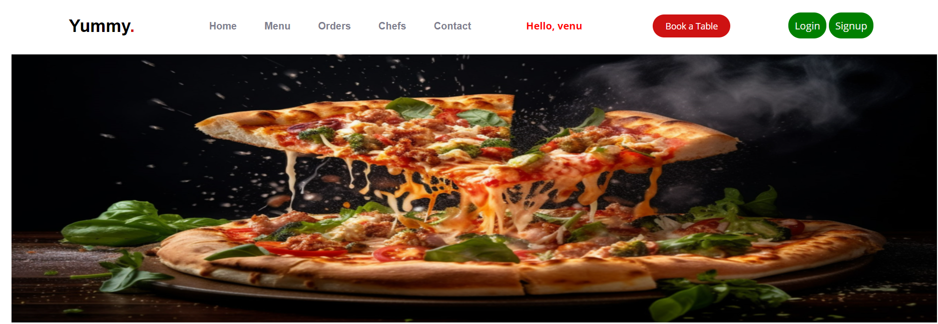
HOME PAGE

Slide 6
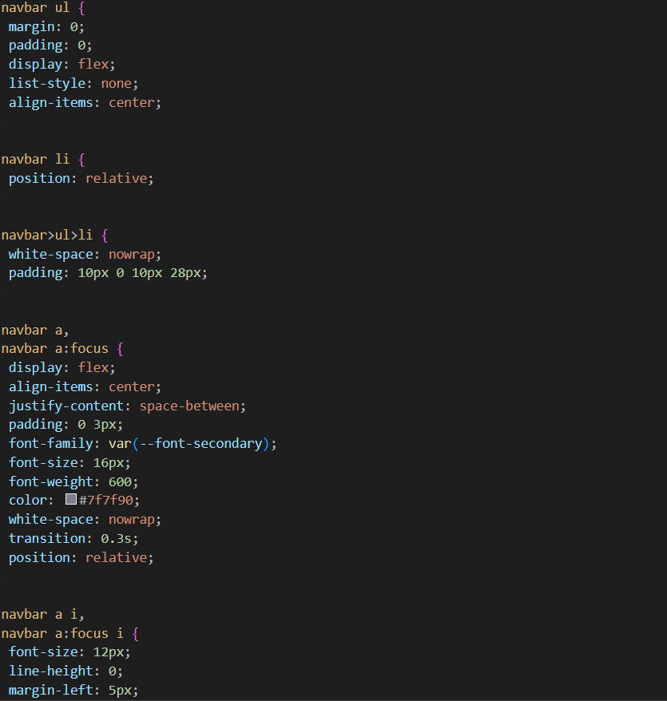
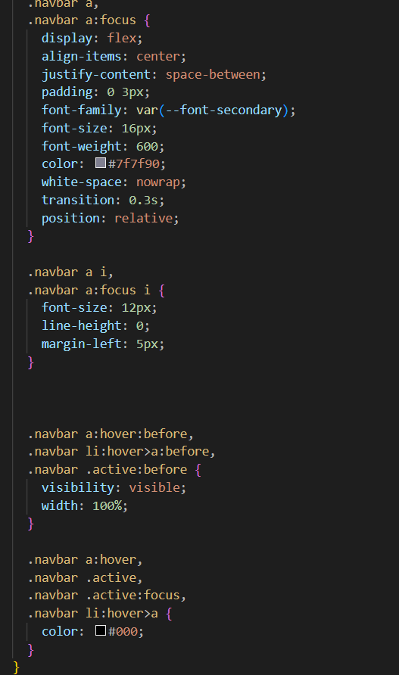
Navbar CSS

Slide 7
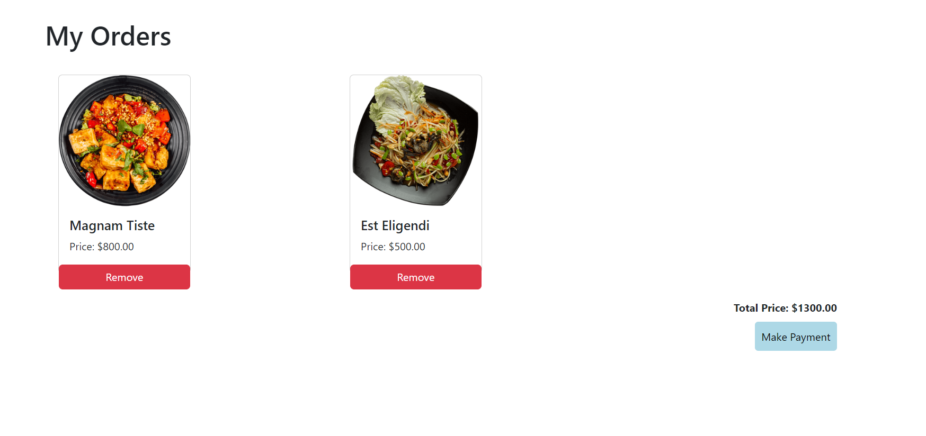
Orders

Slide 8
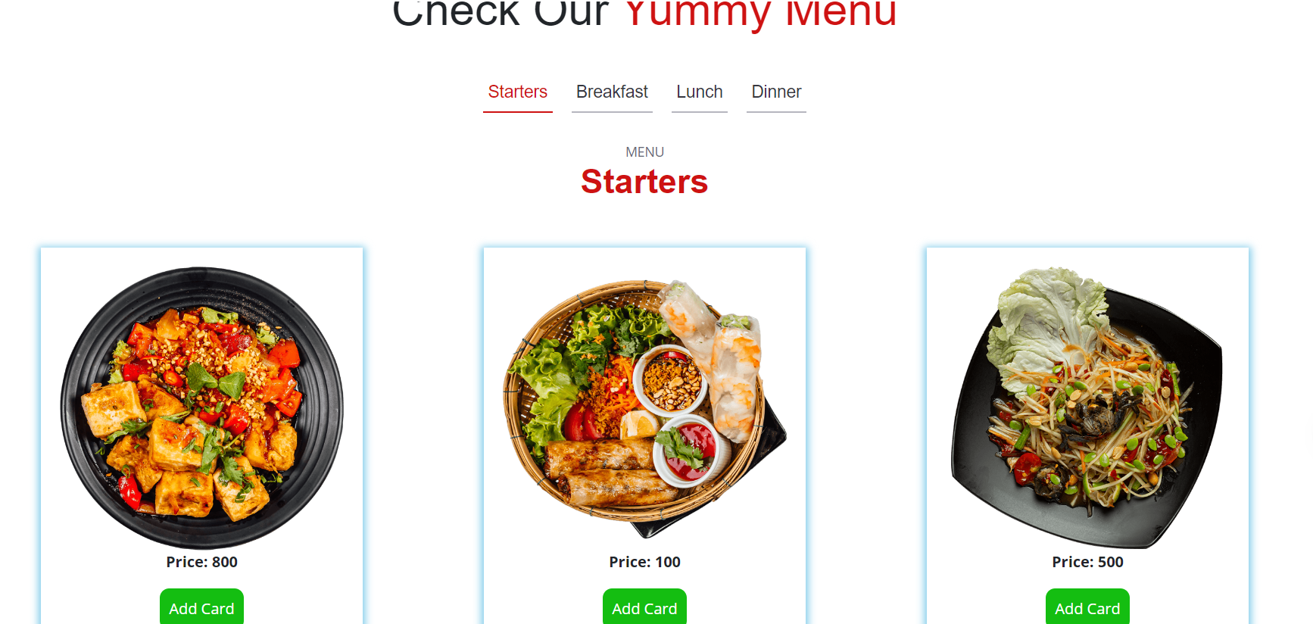
MENU PAGE

Slide 9
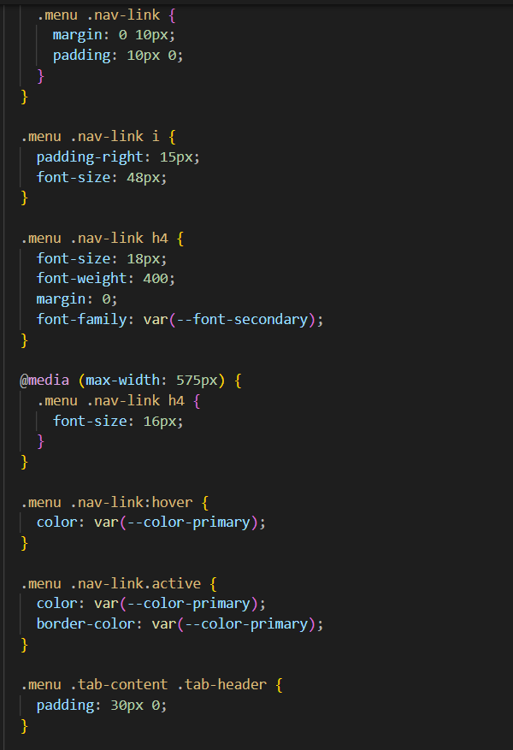
Menu CSS

Slide 10
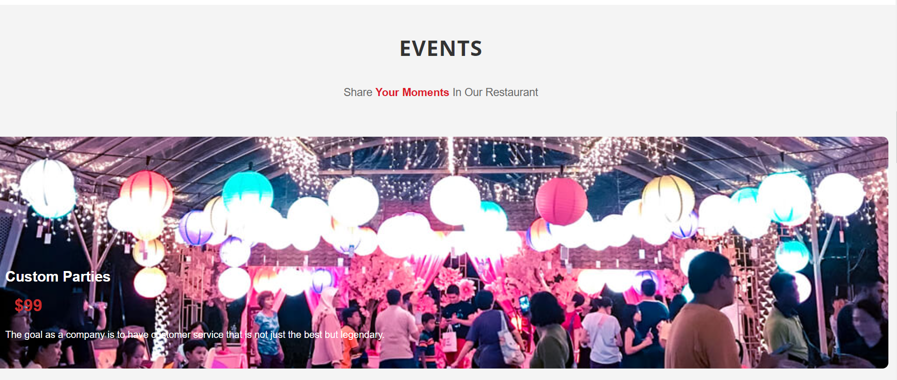
EVENTS

Slide 11
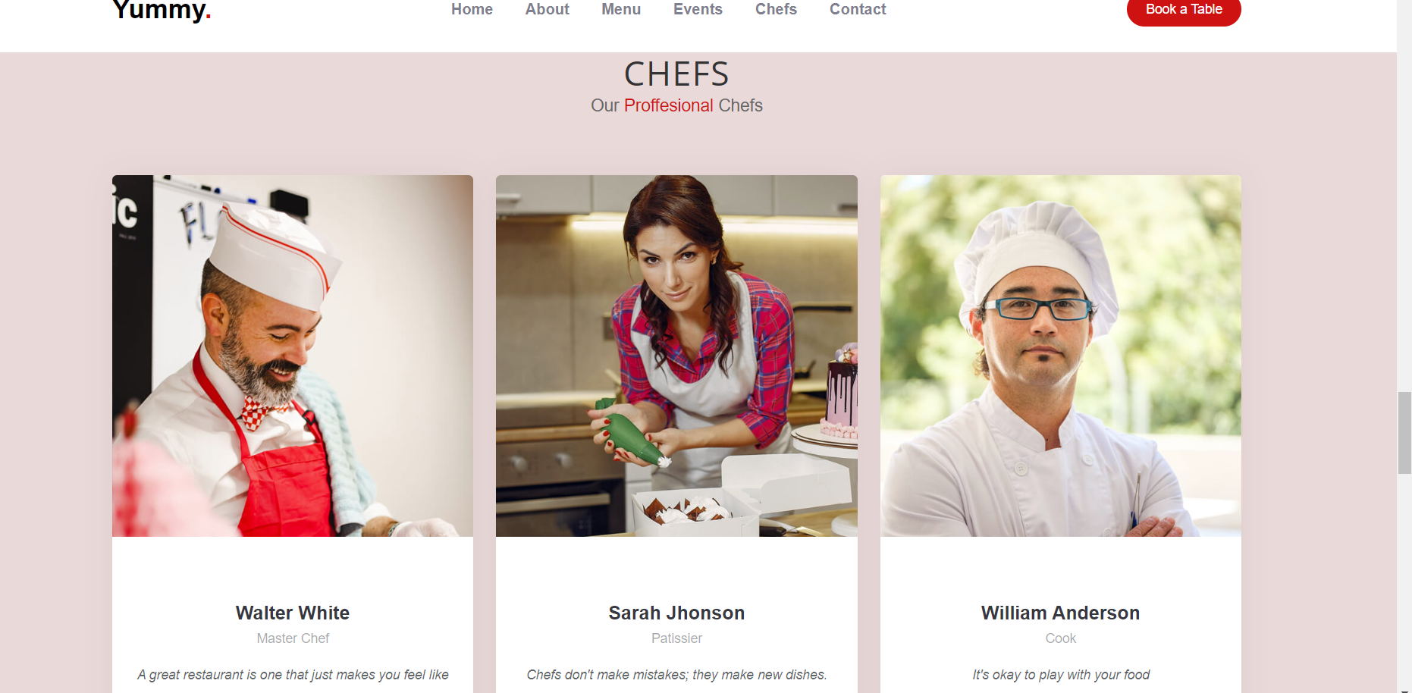
CHEFS PROFILE

Slide 12
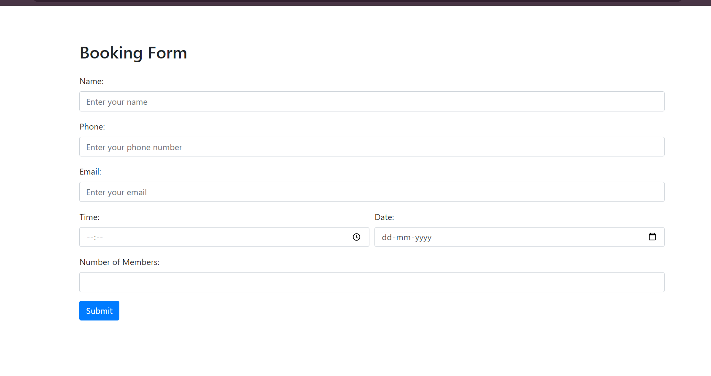
BOOKING TABLE

Slide 13
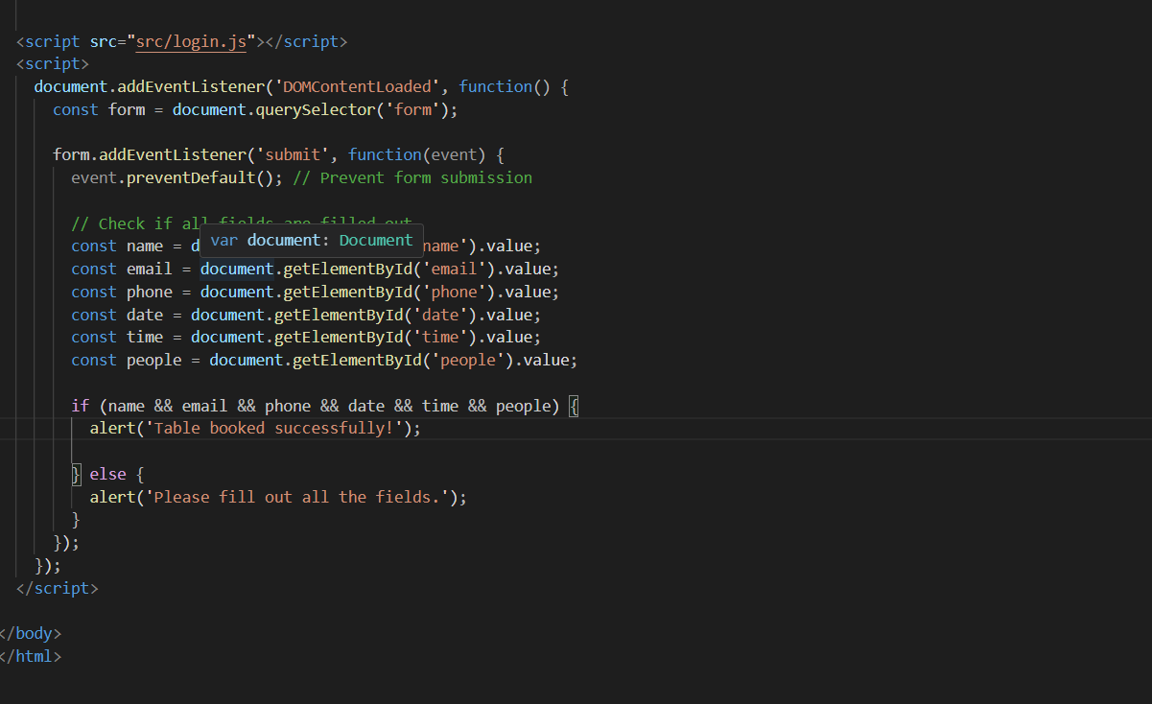
JavaScript code for Booking Table
Certainly! Below is a basic example of JavaScript code for a table booking form. This code assumes you have an HTML form with fields for the customer's name, email, phone number, date, time, and number of guests, and a button to submit the form

Slide 14
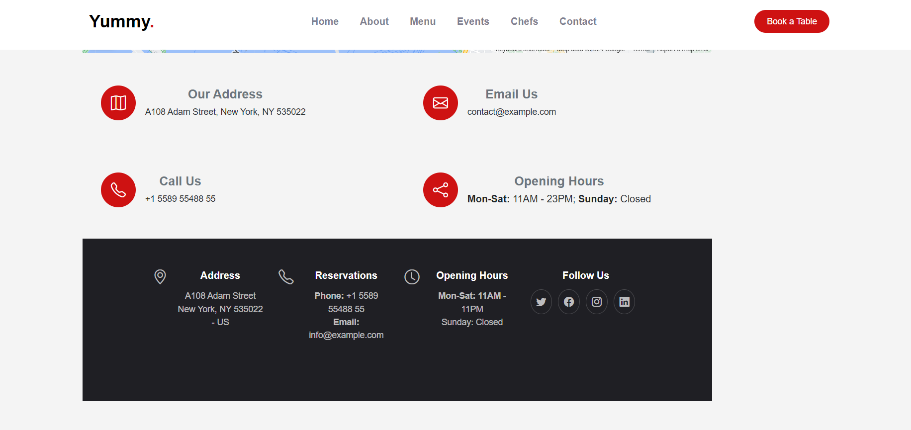
CONTACT

Slide 15
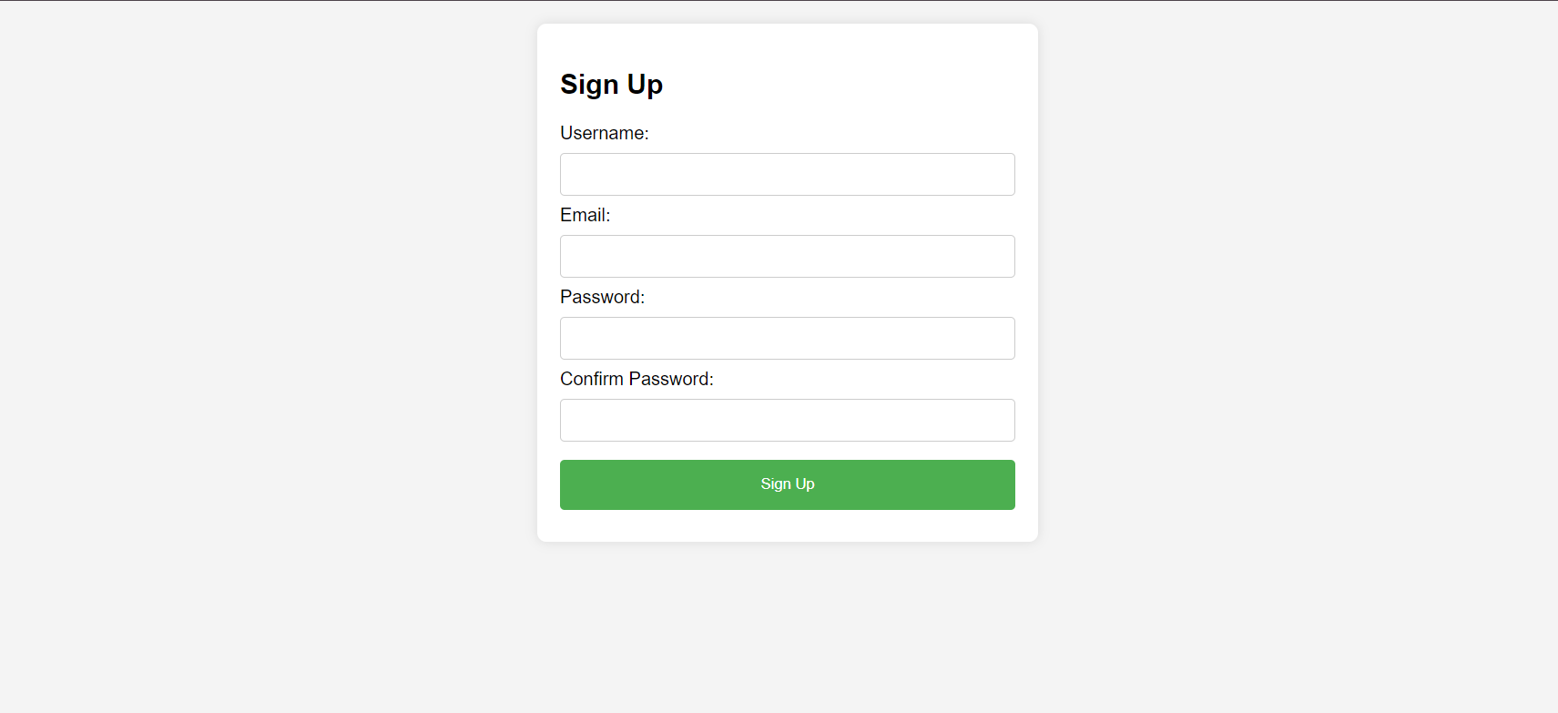
Signup Page

Slide 16
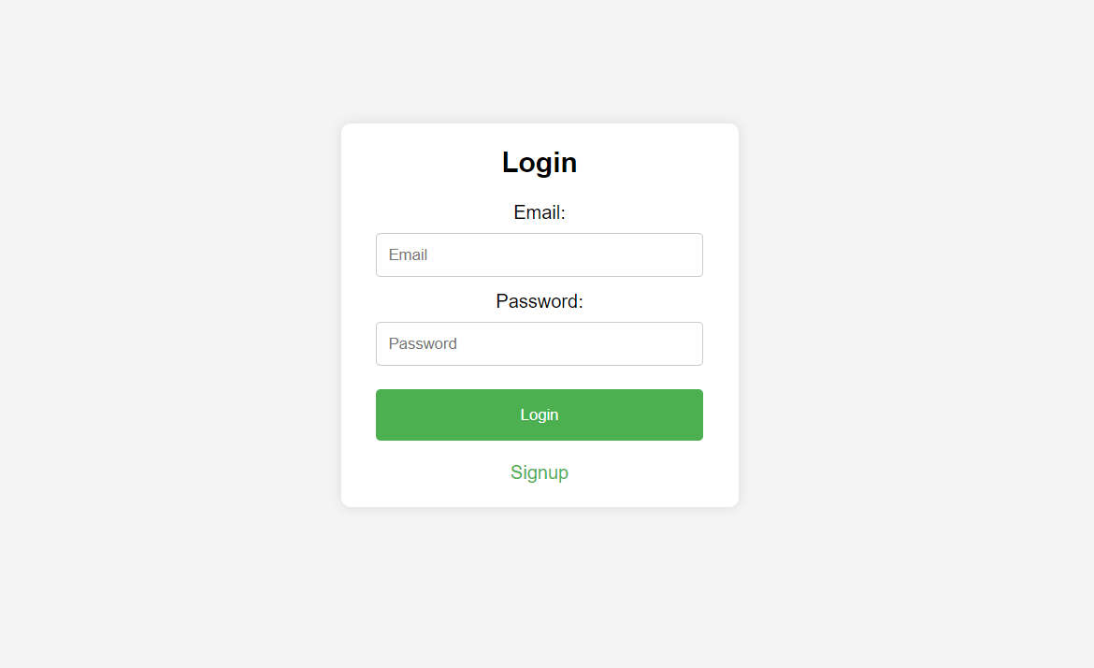
Login Page

Slide 17
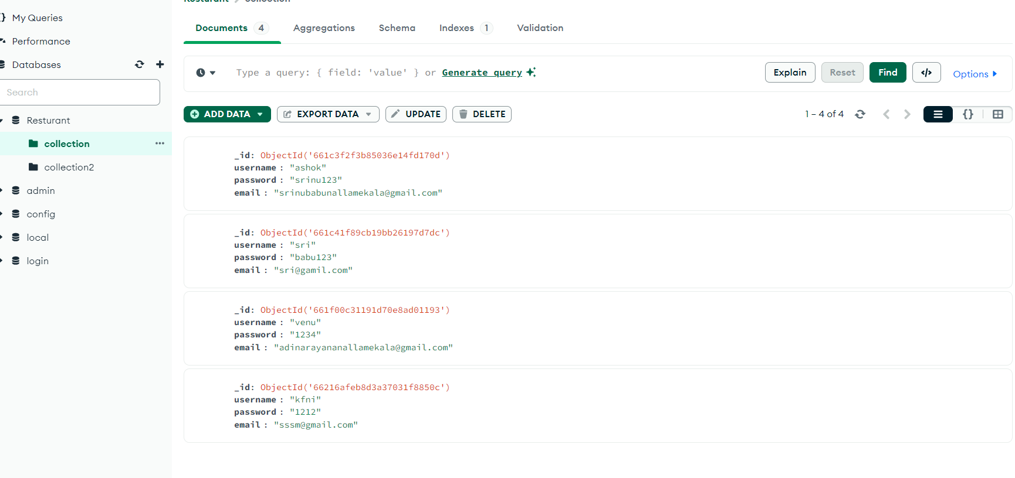
MONGO DB

Slide 18
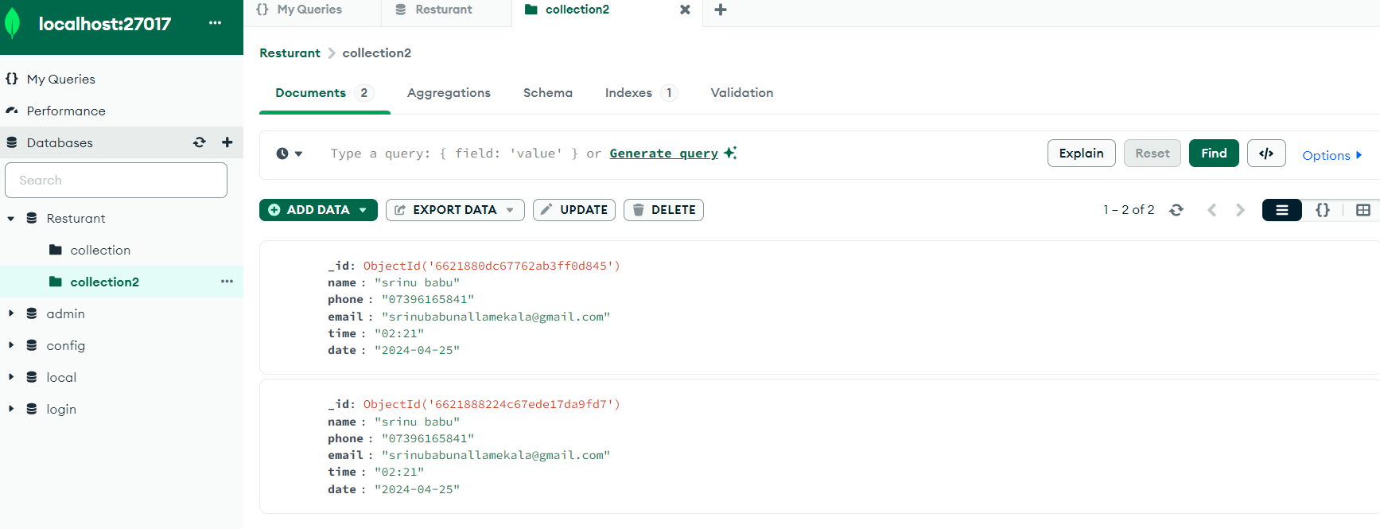

Slide 19
CONCLUSION
The project sounds like it was built on a solid foundation of modern web technologies, leveraging each tool and framework effectively to create a robust and scalable solution. Here's a breakdown of the key components and their roles:
HTML, CSS, and JavaScript: These are the fundamental building blocks of web development, providing the structure, style, and interactivity for the application.
MDN Web Docs: Using the guidance and documentation from MDN ensured adherence to best practices and standards, promoting a high-quality codebase.
jQuery: Employed for dynamic client-side interactions, jQuery streamlined DOM manipulation and event handling, simplifying the development process.

Slide 20
Bootstrap: Incorporated to ehance the user interface, Bootstrap ensured responsiveness across different devices and screen sizes. Its extensive collection of CSS and JavaScript components expedited development and maintained a consistent design aesthetic.
By combining these technologies, the project delivered a dynamic and feature-rich web application that excelled in performance, scalability, and user experience. Each component played a vital role in achieving these goals, demonstrating the power of leveraging modern web development technologies.
MongoDB: Integrated as the backend database, MongoDB facilitated efficient storage and retrieval of data for the web application. Its NoSQL document-oriented approach provided flexibility in handling diverse data types, enabling seamless integration with the Node.js backend. With MongoDB, the application efficiently managed user profiles, menu items, and other dynamic content, ensuring smooth operation and scalability as the data volume grew.
Node.js: Utilized as the backend runtime environment, Node.js empowered the web application with server-side JavaScript execution. Its event-driven, non-blocking I/O model facilitated high-performance handling of concurrent operations, enhancing the application's responsiveness and scalability. Node.js seamlessly interacted with MongoDB, processing user requests, managing sessions, and delivering dynamic content to the client-side interface. The combination of Node.js and MongoDB created a robust and efficient backend architecture, laying the foundation for a modern, feature-rich web application.

Slide 21
GITHUB LINK:
https://github.com/Srinubabu123/Nodejs-Project-Resturant
This link directs to the GitHub repository for the Food Restaurant Website project, providing access to the source code and project documentation

Slide 22
References
MDN Web Docs for HTML, CSS, JavaScript: https://developer.mozilla.org/
jQuery Official Website: https://jquery.com/
Bootstrap Official Website: https://getbootstrap.com/
Node.js Official Website: https://nodejs.org/
MongoDB Official Website: https://www.mongodb.com/

Slide 23


